Slide 1
Project idea for the summer:
Investigation of Li nucleation
Gottfrid Olsson and Josef Rizell
2024-06-05

Slide 2
Scientific questions
Does a more passivated electrode lead to more instantaneous nucleation?
Instantaneous nucleation: large dN/dC for small C, small dN/dC for large C
When do nuclei stop forming?
What is the shape of the function N(t)?
When does whisker/nodular growth start?
How does the pressure influence?
(Does a higher overpotential at the nucleation region lead to more uniform deposition at the end of the deposition?)

Slide 3
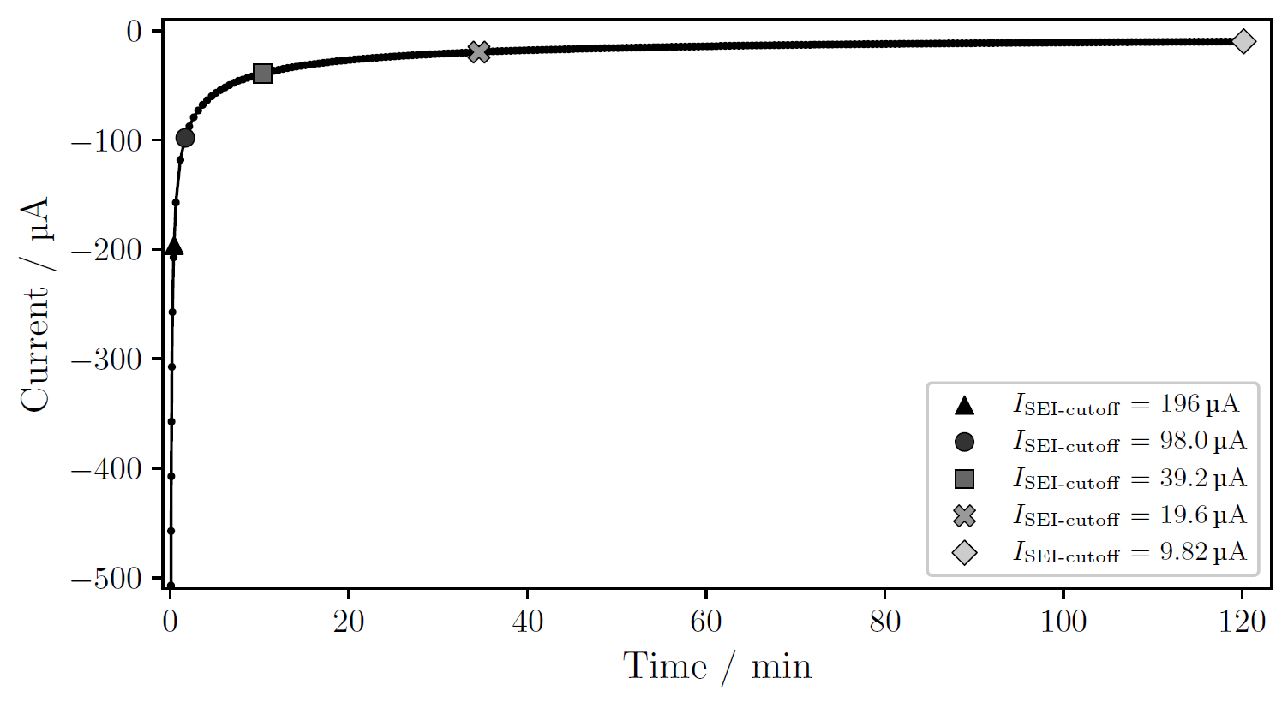
Does a more passivated electrode lead to more instantaneous nucleation?
(I) Passivation
I / A
t / h

Slide 4
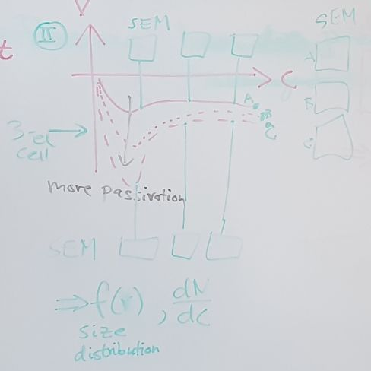
Does a more passivated electrode lead to more instantaneous nucleation?
(II) Voltage deposition profile
E / V
C / Ah cm⁻²

Slide 5
Does a more passivated electrode lead to more instantaneous nucleation?
(II) Voltage deposition profile with SEM images
E / V
C / Ah cm⁻²
(A)
(B)

Slide 6
Does a more passivated electrode lead to more instantaneous nucleation?
(III) N(C) and dV/dC
N
(B)
(A)
C / Ah cm⁻²
dV/dC
(B)
C / Ah cm⁻²
(A)

Slide 7
Does a more passivated electrode lead to more instantaneous nucleation?
(III) N(C) and dV/dC (IV) Nuclei size distribution
N
(B)
n
(B)
(A)
C₁
(A)
r / μm
C / Ah cm⁻²
C₂
dV/dC
r / μm
(B)
C₃
C / Ah cm⁻²
(A)
r / μm

Slide 8
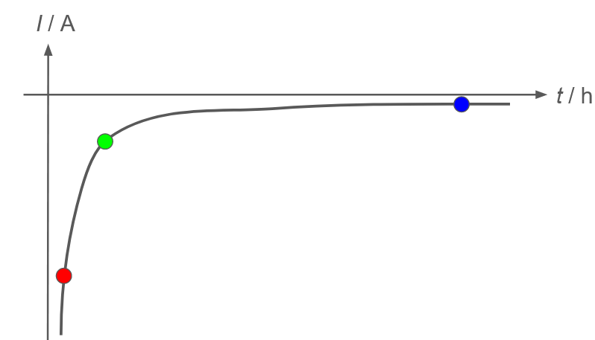
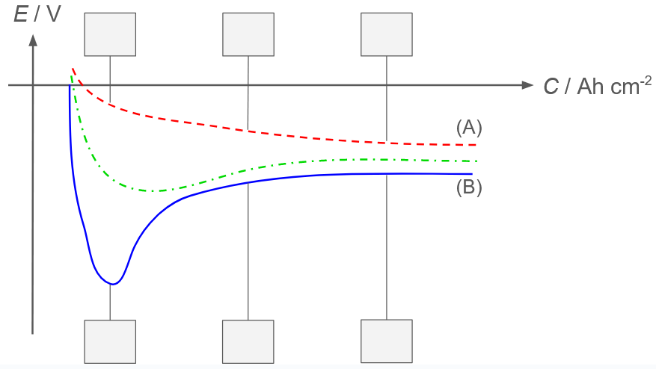
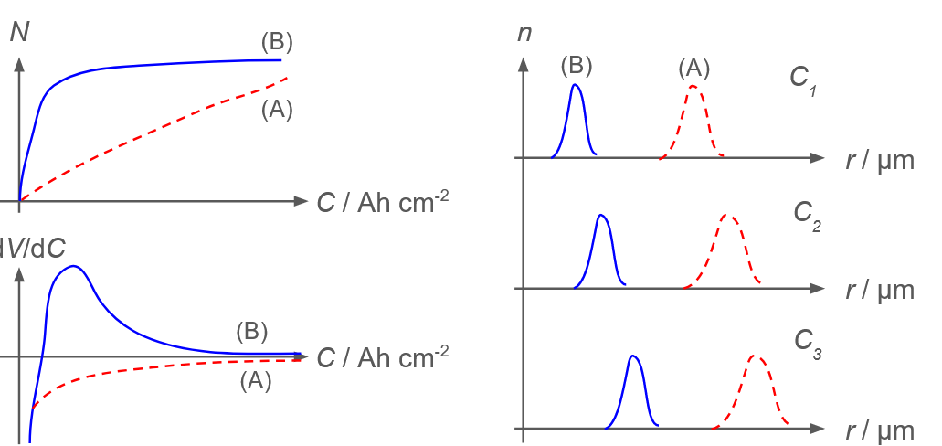
Does a more passivated electrode lead to more instantaneous nucleation?

Slide 9
2) When do nuclei stop forming?
What is the shape of the function N(t)?

Slide 10
3) When does whisker/nodular growth start?
How does pressure influence?
SEM images
One series with another pressure to compare

Slide 12
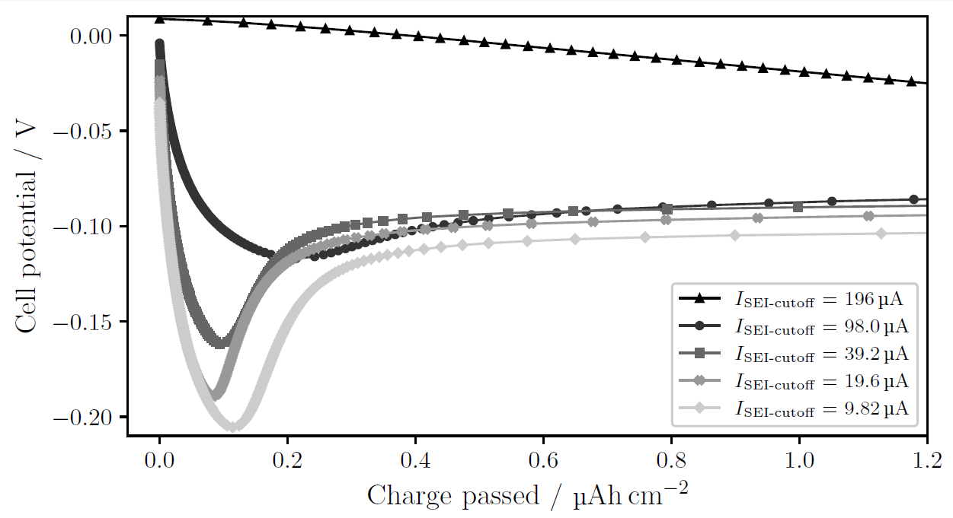
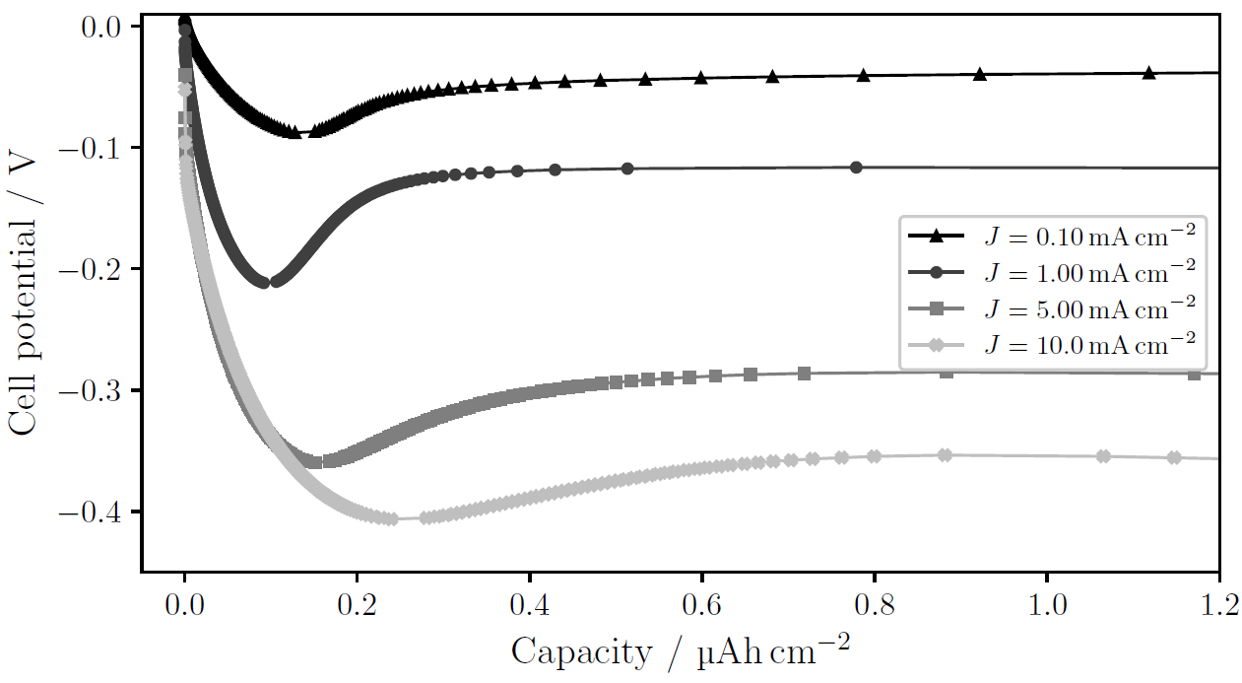
Does a more passivated electrode lead to more instantaneous nucleation?
Supplementary
Same J
Different degree of passivation
Different J
Same degree of passivation

